Slide 1

The Q3 Strategy
Planning for the Open Question

Slide 2
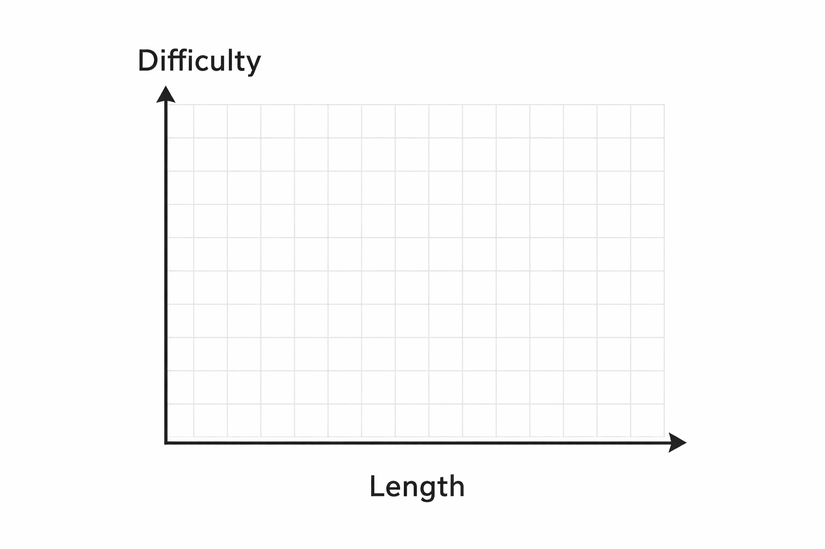
Considering texts for Q3
Technically, anything can be used on the open essay.
[Insert random questions here]
However, just because you CAN write about anything, doesn’t mean you SHOULD.
Over the next 3 months, we’re curating a short list of a strong works to reread or study for the AP Lit exam.
Books should be:
  Written for an adult audience
  Contain at least one symbol and several themes
Consider the chart on the right. The higher the difficulty and length, the more complex it’s likely to be.

Slide 3

1 - Examine the Reading Inventory
Circle any books you’ve read in these classes
Write in your selections for independent reading for AP Lit
Under Other Books, write any other titles you’ve read that you could analyze for an open essay prompt
Use the chart to determine if a book is “AP worthy” (or ask me)

Slide 4
2 – About the “reading list”
Every Q3 prompt includes a list of “suggested titles.”
I’ve compiled all of these titles into a list, that you can look it.
  It will not make you feel good.
If you want, you can highlight any you’ve read, but it probably won’t be a majority
What these books have in common:
  Award winners (Pulitzer, Nobel)
  Old (1950 or earlier)
  Classic (commonly read or taught)
Just because a book isn’t on the list, doesn’t mean it can’t be used. None of these books are on the list and I would write about any of them!
  The Heaven and Earth Grocery Store
  Between Shades of Gray
  Remarkably Bright Creatures
  A Man Called Ove or Beartown
  Room
  Les Misérables

Slide 5
3 – Thinking about prompts
While it can be easy just to pick your “favorite” books, not every book works with every prompt.
Study the following prompts and, using your reading inventory, write down any that COULD work to write about.
2025 Set 1
2022
2021
2018
2002

Slide 6
4 – Create a Shortlist
Make a list of 10 books that you COULD use for the AP Lit exam.
We will shorten this list again in April.
Consider choosing one of these books to reread, either for a Q4 independent reading or in your spare time.
My suggested game plan:
2-3 Independent reads
2-3 rereads from electives or 9th or 10th grade
3-6 books from AP Lit or senior year
Consider:
  Including at least one play
  Including at least one classic (pre 20th century)
  Including at least one female author
  Including at least two contemporary texts (1980 or later)
  Including diverse voices (from other countries or of different ethnicities than your own)

