Slide 1
The AP Lit Olympics

Slide 2
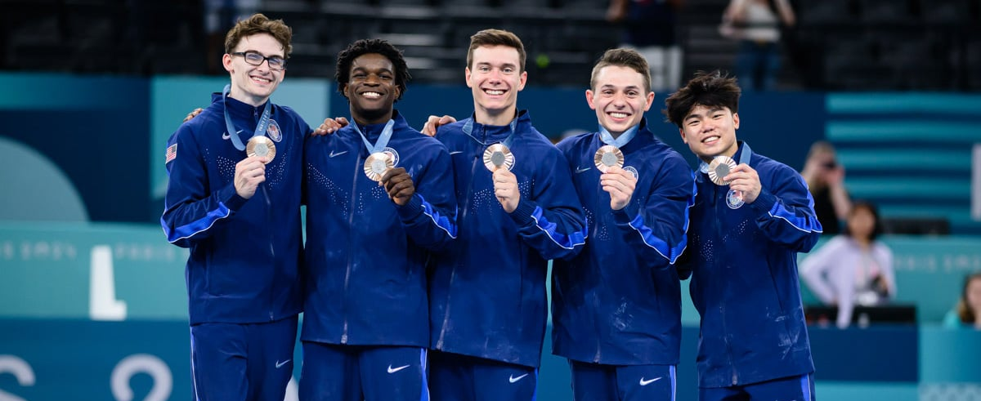
Get into teams of 3-4
Come up with a team name

Slide 3

The Rules
You will be working with teams for most of these challenges, earning points for yourself and your teammates.
Speed earns points, but strong analysis & interpretation earns more.
This Photo by Unknown Author is licensed under CC BY-SA

Slide 4
Read “This is just to say” by William Carlos Williams
Event 1 – 60 second close read

Slide 5
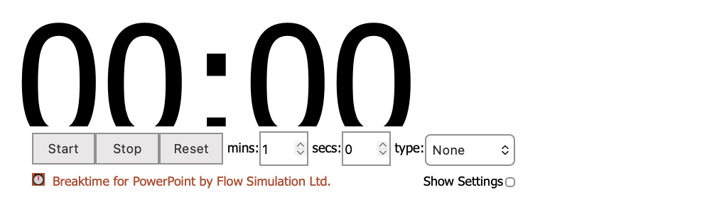
Event 1 – 60 Second Close Read
Identify ONE interesting choice the writer makes. Write it on your score sheet.

Slide 6
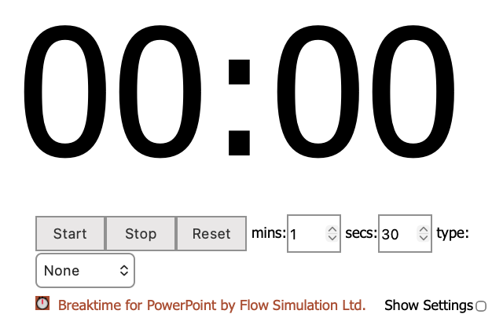
Event 1 – 60 second close read
Explain why that choice matters. Write it on your score sheet.

Slide 7
Event 1 Scoring
Points will be awarded with the following rubric:
Identifies a meaningful detail or literary device – 1
Explains its effect – 2
Connects it to meaning (“why does this matter?”) - 2
In AP Lit, we never just identify literary devices or unique text effects. We always explain the effect of that choice on interpreting the meaning of the text.

Slide 8
Read this excerpt from “One Morning in June”
Event 2 – Literary CSI

Slide 9
Literary CSI
Read over this passage. Please note, the final piece of this text has been removed.
With your team, answer this question:
What do you predict the missing sentence will do?
Don’t guess exact words, but instead guess how the sentence will affect the function of the text overall. You might consider:
Conflict
Character
Tone
Irony
Reader interpretation

Slide 10
Literary CSI - scoring
The missing sentence: It was rather like exposing someone to a case of measles and watching for spots to break out.
What is the effect of this sentence on these elements?
  Conflict
  Character
  Tone
  Irony
  Reader interpretation
Scores are awarded as such:
Best Prediction – 3 points
Best Evidence – 3 points
Most Convincing Wrong Answer – 1 point

Slide 11
Event 3 – Paragraph Showdown

Slide 12
Paragraph Showdown
Select one analytical statement from the list below:
The character’s greatest weakness is actually their greatest strength.
The setting functions as more than just a backdrop.
The purpose for a character’s movement shifts into something more thematic over the course of a narrative.

Slide 13
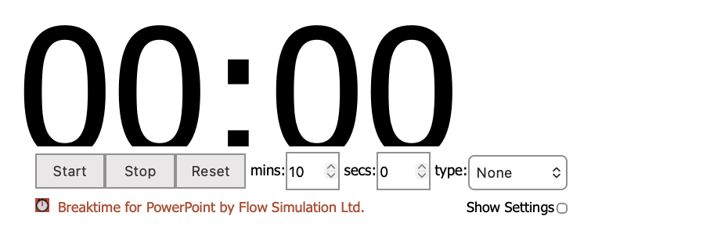
APE showdown
Apply your chosen statement to a text (can’t be a movie) and agree, disagree, or find an answer somewhere in the middle.
Produce an APE (assert-prove-explain) paragraph that includes 1) your arguable claim; 2) a piece of evidence; 3) an explanation of why it matters.

Slide 14
APE showdown scoring
I will read your APE paragraphs. The scores are determined with the following rubric:
Evidence – 2 points
Explanation – 3 points
Mechanics – 1 point
Style – 1 point

Slide 15
Read “Digging” by Seamus Heaney
Event 4 – Evidence Hunt

Slide 16
Evidence Hunt
Examine the following claim:
The speaker in “Digging” honors family’s generational practice of farming despite ending it.
Then, with your group, walk through the room and examine portions of this poem cut up into quotes.
Select three quotes you would use to strengthen this claim. Put them in the order you would use if writing one solid analytical paragraph. Be prepared to explain your thinking process.

Slide 17
Evidence Hunt Scoring
For each piece of evidence, you will receive a score.
1 – Evidence is irrelevant and does not seem to be the best fit for this claim.
2 - Evidence seems irrelevant but you made a compelling or persuasive argument for how it could work to support the claim.
3 – Evidence is very compelling and strongly supports the evolving argument.

Slide 18
This event is done individually
Event 5 – One Strong THESIS

Slide 19
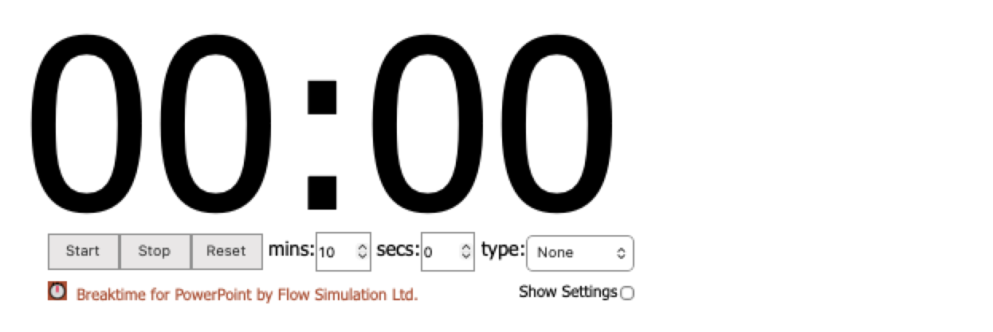
Event 5 – One Strong Thesis
Read the rest of “One Morning in June” by Mavis Gallant. Read the excerpt. Then, produce ONE defensible thesis explaining Mike’s complex perspective on studying painting.

Slide 20

Event 5 Scoring
We will vote anonymously on:
Most defensible – 5 points
Most insightful – 5 points
Most surprising interpretation – 3 points
Most sophisticated/stylish – 3 points

